Slide 1
Matrix
Algebra

Slide 2
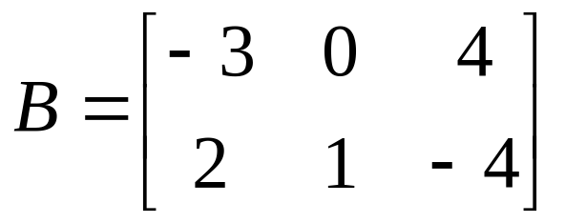
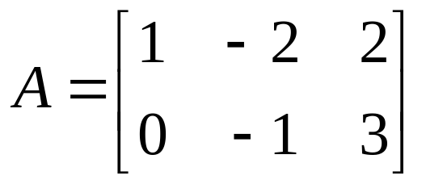
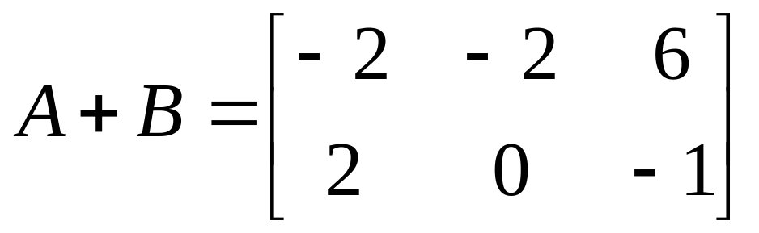
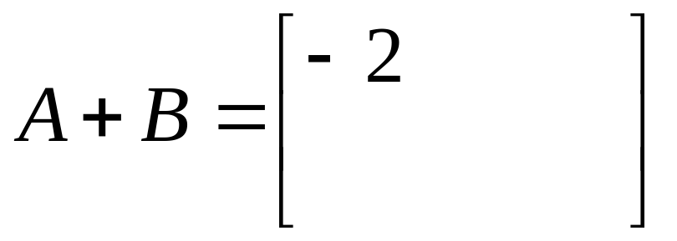
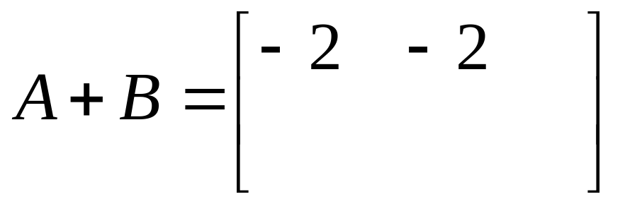
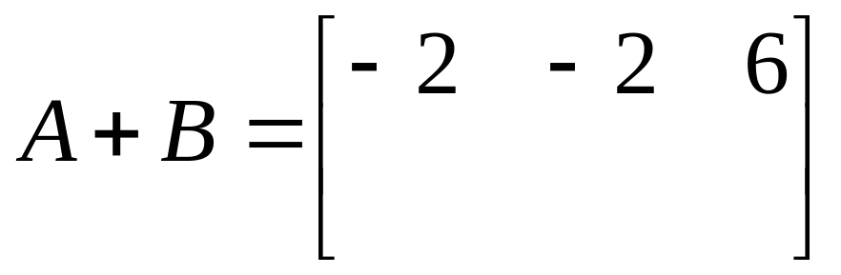
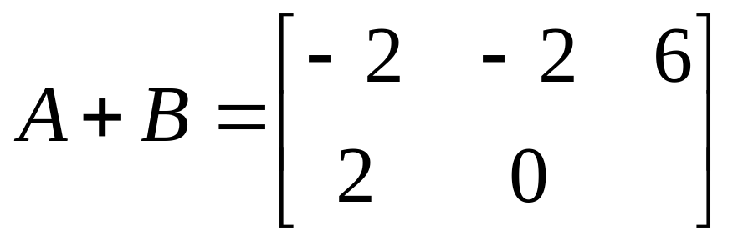
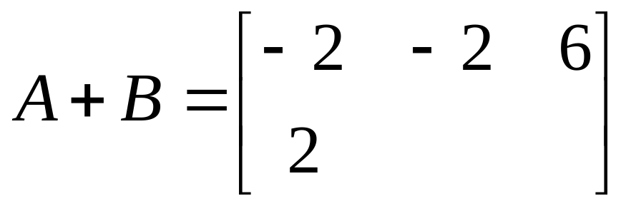
Addition of Matrices
If A and B are both m × n matrices then the sum of A and B, denoted A + B, is a matrix obtained by adding corresponding elements of A and B.
If A and B are both m × n matrices then the sum of A and B, denoted A + B, is a matrix obtained by adding corresponding elements of A and B.
add these
add these
add these
add these
add these
add these

Slide 3
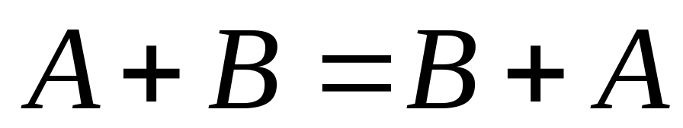
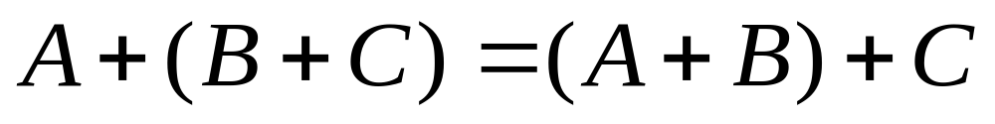
Matrix
addition is
commutative
Matrix
addition is
associative

Slide 4
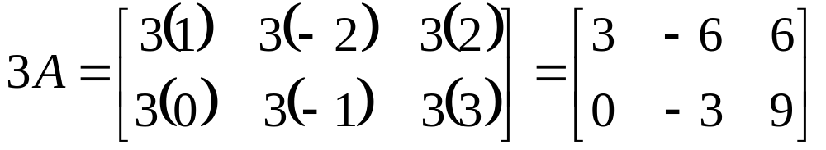
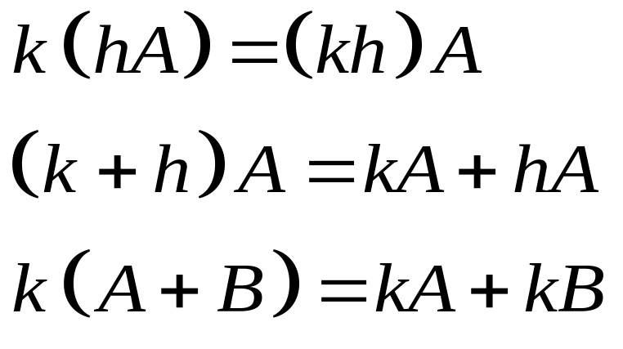
Scalar Multiplication of Matrices
If A is an m × n matrix and s is a scalar, then we let kA denote the matrix obtained by multiplying every element of A by k. This procedure is called scalar multiplication.
PROPERTIES OF SCALAR MULTIPLICATION

Slide 5
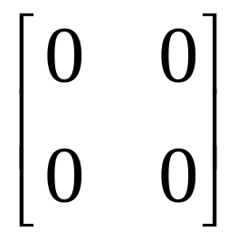
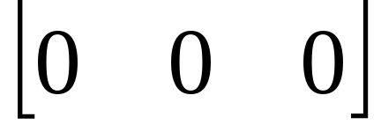
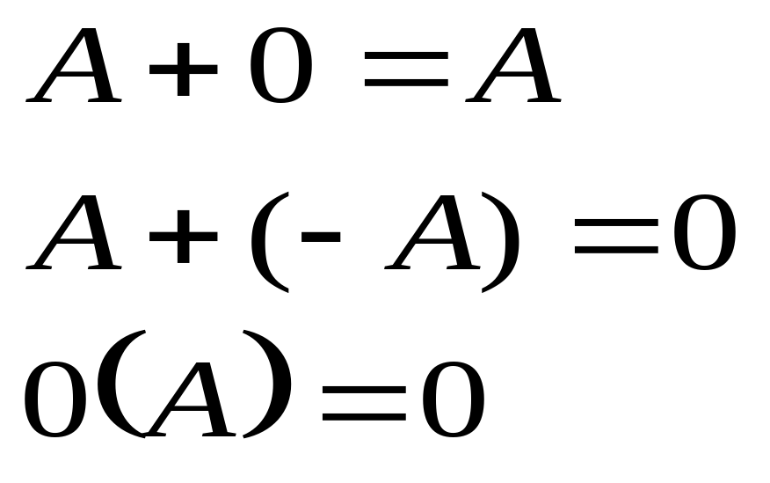
The m × n zero matrix, denoted 0, is the m × n matrix whose elements are all zeros.
1 × 3
2 × 2

Slide 6
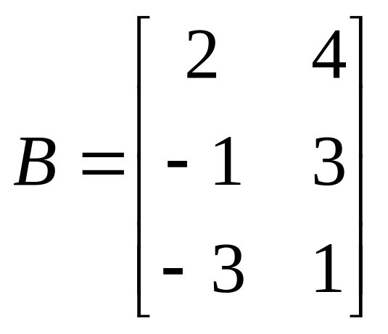
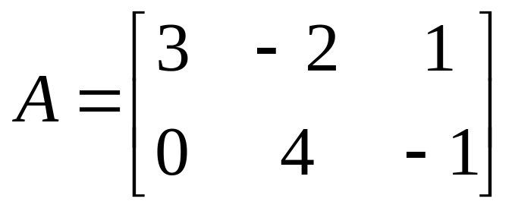
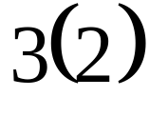
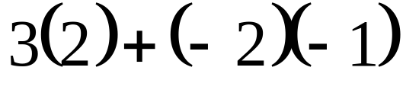
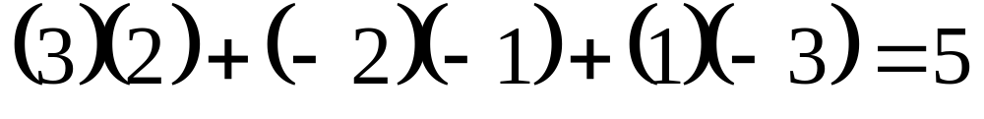
Multiplication of Matrices
The multiplication of matrices is easier shown than put into words. You multiply the rows of the first matrix with the columns of the second adding products
Find AB
First we multiply across the first row and down the first column adding products. We put the answer in the first row, first column of the answer.

Slide 7
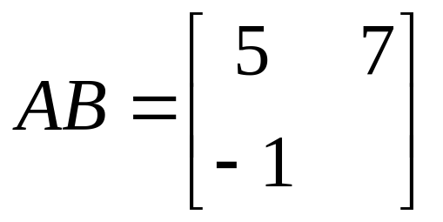
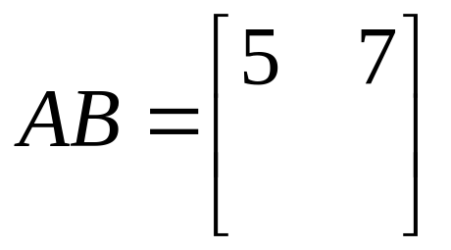
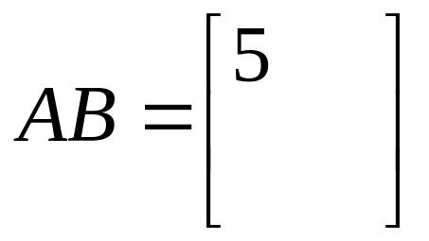
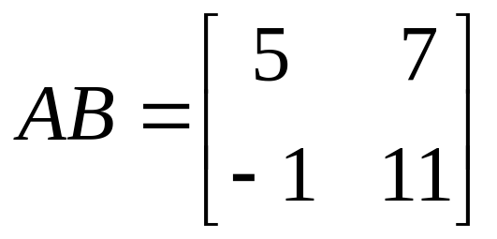
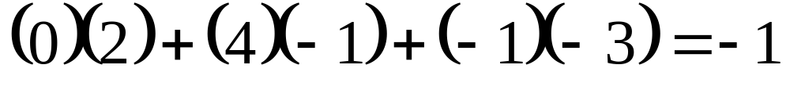
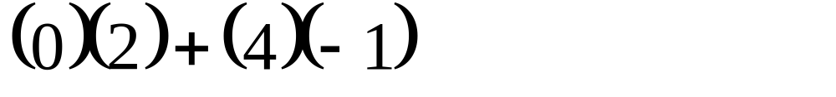
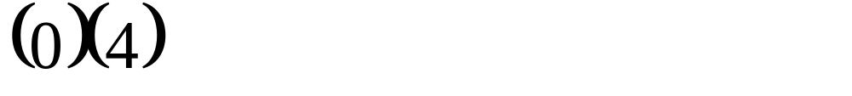
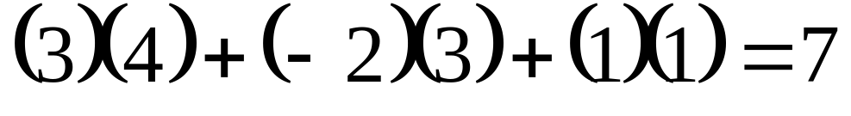
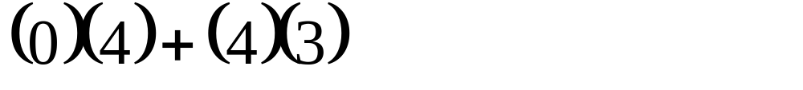
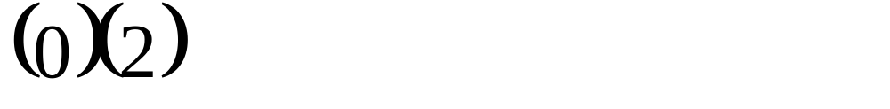
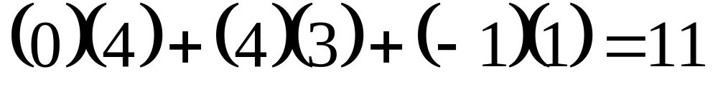
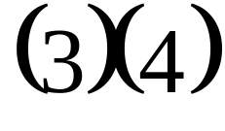
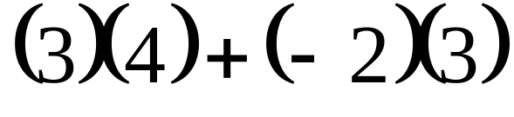
Find AB
Notice the sizes of A and B and the size of the product AB.
Now we multiply across the first row and down the second column and we’ll put the answer in the first row, second column.
Now we multiply across the second row and down the first column and we’ll put the answer in the second row, first column.
Now we multiply across the second row and down the second column and we’ll put the answer in the second row, second column.
We multiplied across first row and down first column so we put the answer in the first row, first column.

Slide 8
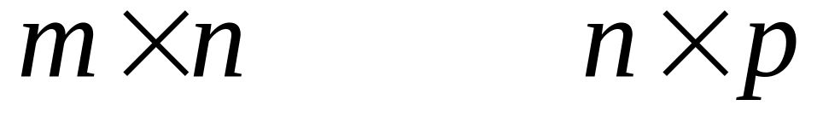
To multiply matrices A and B look at their dimensions
MUST BE SAME
SIZE OF PRODUCT
If the number of columns of A does not equal the number of rows of B then the product AB is undefined.

Slide 9
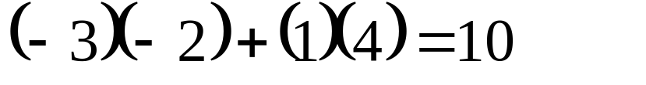
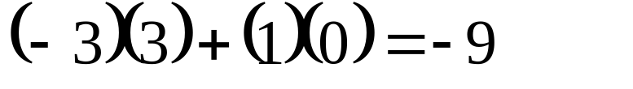
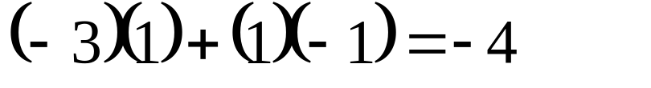
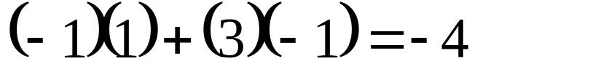
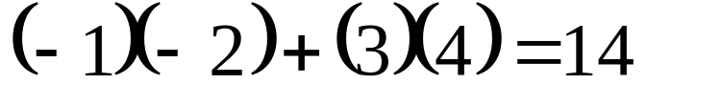
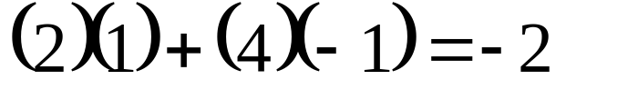
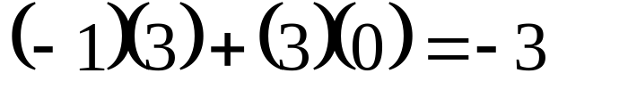
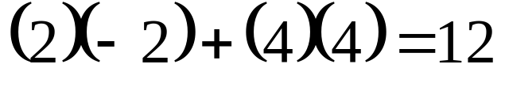
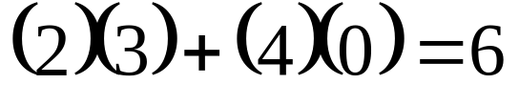
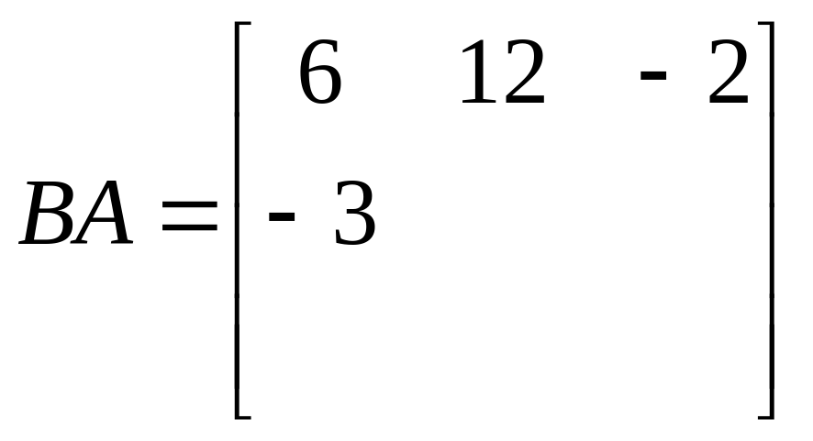
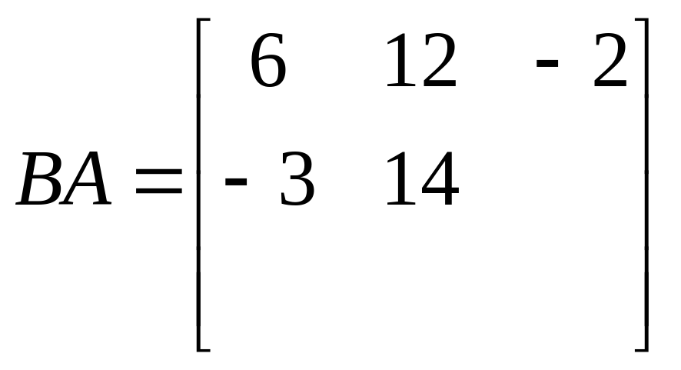
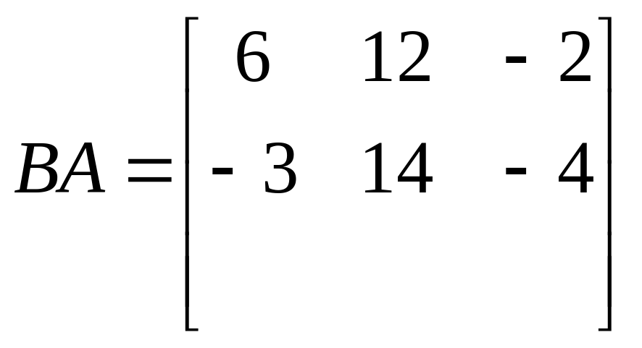
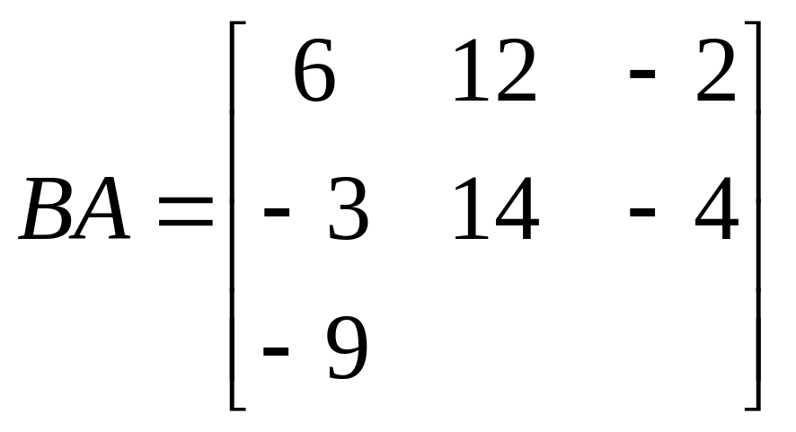
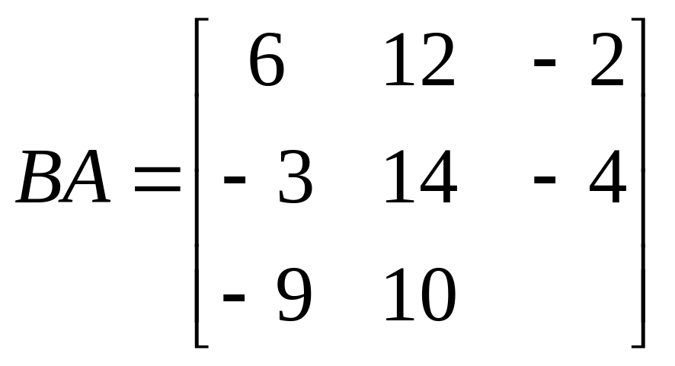
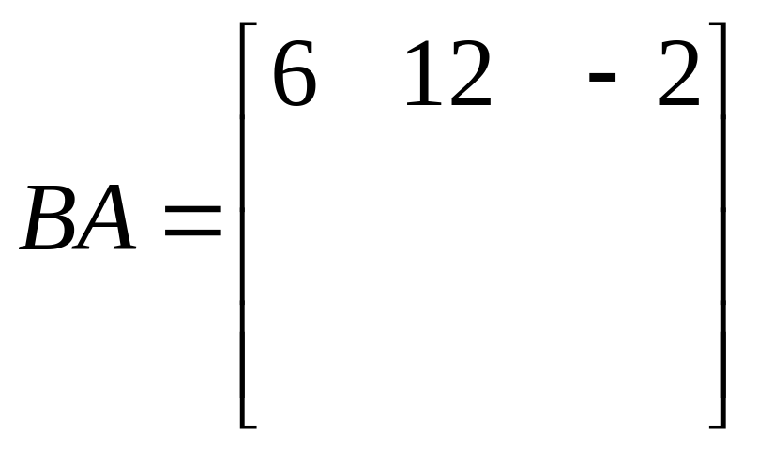
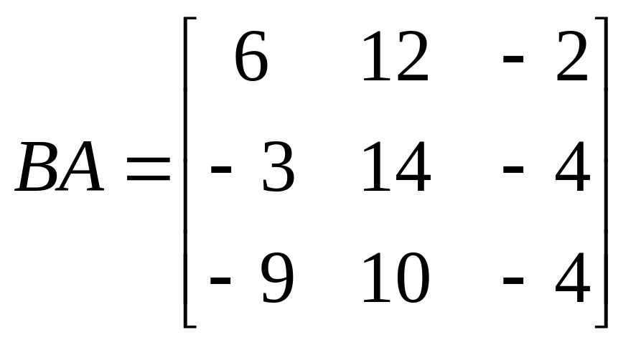




Now let’s look at the product BA.
can multiply
2×3
3×2
across second row as we go down third column:
across third row as we go down first column:
across third row as we go down second column:
across second row as we go down second column:
across third row as we go down third column:
across first row as we go down first column:
across first row as we go down second column:
across first row as we go down third column:
across second row as we go down first column:
size of answer
Commuter's Beware!
Completely different than AB!

Slide 10

PROPERTIES OF MATRIX MULTIPLICATION
Is it possible for AB = BA ?
,yes it is possible.

Slide 11



Multiplying a matrix by the identity gives the matrix back again.
What is AI?
What is IA?
identity matrix
an n × n matrix with ones on the main diagonal and zeros elsewhere

Slide 12



Can we find a matrix to multiply the first matrix by to get the identity?
?
Let A be an n× n matrix. If there exists a matrix B such that AB = BA = I then we call this matrix the inverse of A and denote it A⁻¹.

Slide 13





If A has an inverse we say that A is nonsingular. If A⁻¹ does not exist we say A is singular.
To find the inverse of a matrix we put the matrix A, a line and then the identity matrix. We then perform row operations on matrix A to turn it into the identity. We carry the row operations across and the right hand side will turn into the inverse.
To find the inverse of a matrix we put the matrix A, a line and then the identity matrix. We then perform row operations on matrix A to turn it into the identity. We carry the row operations across and the right hand side will turn into the inverse.
−r₂
r₁ − r₂
2r₁+r₂

Slide 14


Check this answer by multiplying. We should get the identity matrix if we’ve found the inverse.

Slide 15





We can use A⁻¹ to solve a system of equations
To see how, we can re-write a system of equations as matrices.
coefficient matrix
variable matrix
constant matrix

Slide 16



left multiply both sides by the inverse of A
This is just the identity
but the identity times a matrix just gives us back the matrix so we have:
This then gives us a formula for finding the variable matrix: Multiply A inverse by the constants.

Slide 17






find the inverse
-2r₁+r₂
r₁-3r₂
-r₂
x
This is the answer to the system
y

